Slide 1

IMPLEMENTING AN IP ADDRESSING SCHEME
By
2010030326-K.Vamshi
2010030024-B.Vegesh Sai
2010030469-P.Vinay Kumar
REVIEW-2

Slide 2
TABLE OF CONTENTS
S.no | Contents
1 | Title of the project
2 | Table of contents
3 | Introduction
4 | Tool and technique used
5 | Comparison between used technique with previous techniques
6 | Flow chart
7 | Implementation/alpha testing
8 | GitHub commits

Slide 3

INTRODUCTION
To connect to the network, a system must have at least one physical network interface. Each network interface must have its own unique IP address. When you add the second network interface, the host then becomes multihomed. By contrast, when you add a second network interface to a host and enable IP forwarding, that host becomes a router. The IP address closure handles address assignment based upon three inputs: requests for addresses, a policy on address assignment, and architectural information about routing and gateways within the network.

Slide 4

CISCO PACKET TRACER
For implementing an IP addressing scheme by IPV6 we using the tool named “CISCO PACKET TRACER”. It is a cross-platform visual simulation tool designed by cisco systems that allows users to create network topologies and imitate modern computer networks. This software allows user to simulate the configuration of cisco routers and switches using a simulated command line interface.

Slide 5
COMPARISIONS Between Ipv4 & Ipv6
IPv4 | IPv6
IPv4 has a 32-bit address length | IPv6 has a 128-bit address length
It Supports Manual and DHCP address configuration | It supports Auto and renumbering address configuration
In IPv4 end to end, connection integrity is Unachievable | In IPv6 end to end, connection integrity is Achievable
It can generate 4.29×10⁹ address space | Address space of IPv6 is quite large it can produce 3.4×10³⁸ address space
The Security feature is dependent on application | IPSEC is an inbuilt security feature in the IPv6 protocol
Address representation of IPv4 is in decimal | Address Representation of IPv6 is in hexadecimal
Fragmentation performed by Sender and forwarding routers | In IPv6 fragmentation performed only by the sender
In IPv4 Packet flow identification is not available | In IPv6 packet flow identification are Available and uses the flow label field in the header
In IPv4 checksum field is available | In IPv6 checksum field is not available
It has broadcast Message Transmission Scheme | In IPv6 multicast and anycast message transmission scheme is available
In IPv4 Encryption and Authentication facility not provided | In IPv6 Encryption and Authentication are provided
IPv4 has a header of 20-60 bytes. | IPv6 has header of 40 bytes fixed

Slide 6

FLOW CHART
Administering Network Numbers.
Designing The IP addressing
Scheme.
Applying IP Address to Network
Interfaces.

Slide 7
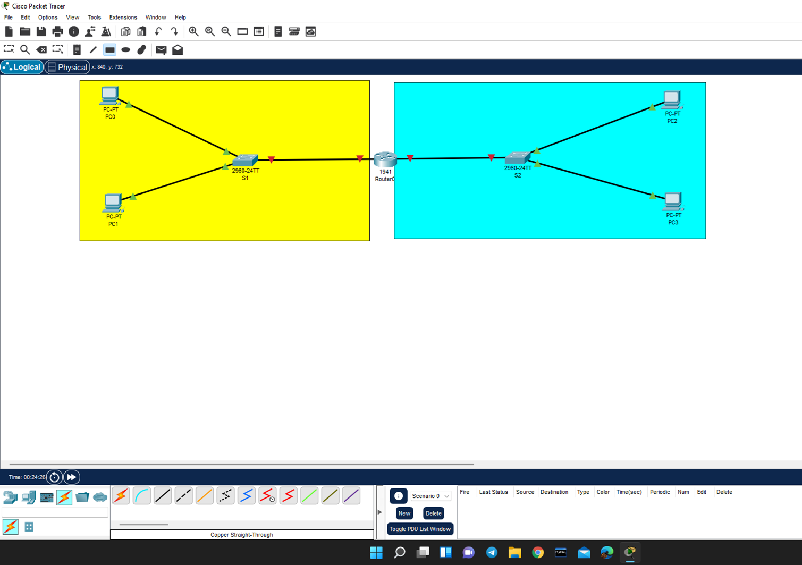
IMPLEMENTATION/ALPHA TESTING
Here there are two networks, the yellow-colored part is the first network and blue colored is the second network. In first network(Yellow region) consist of two devices(PC0 & PC1) associated to the switch (S1) which is connected to router(router0),In the same way second network(blue region) consist of two devices(PC2 & PC3) associated to the switch (S2) which is connected to router(router0).

Slide 8
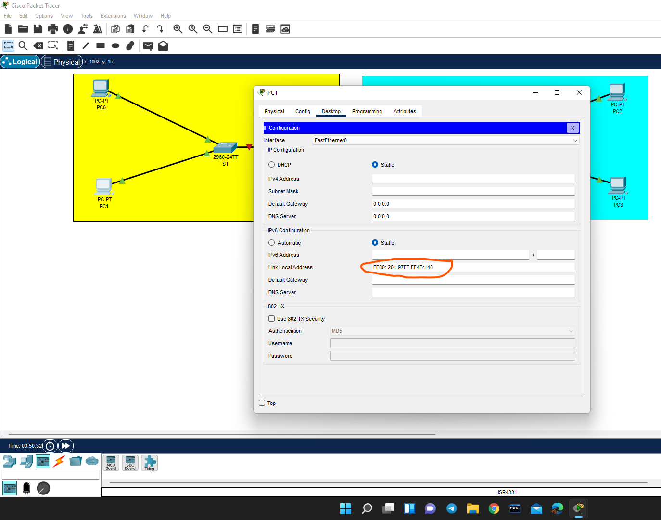
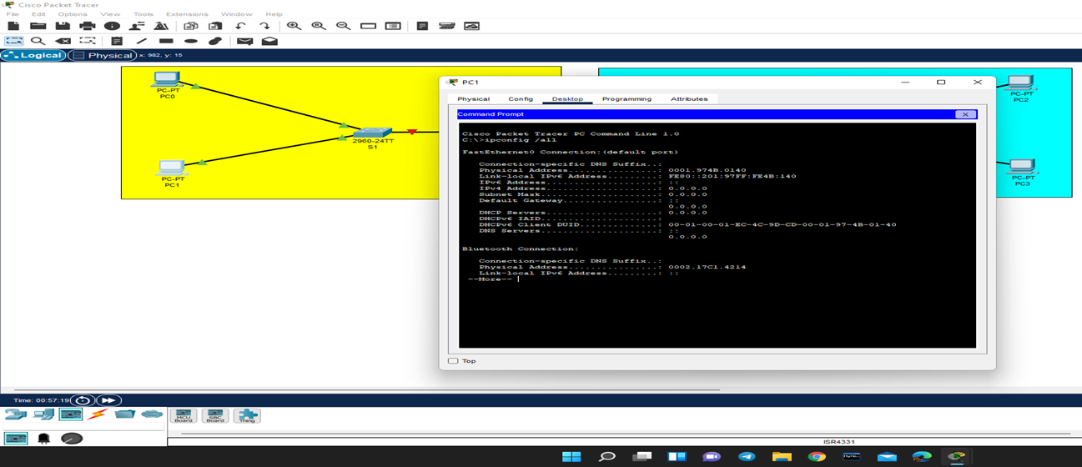
Local address
Basing upon the physical address the Local address is generated

Slide 9
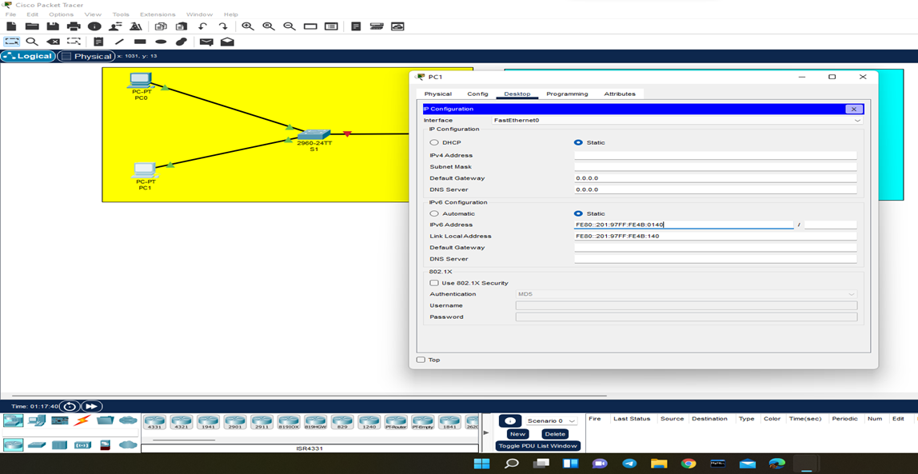
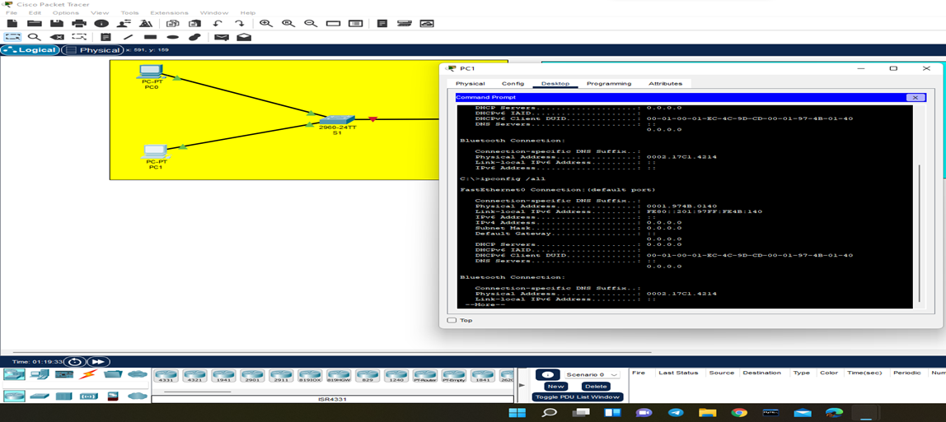
Calculating the local address and verifying them with present local address for every PC

Slide 10
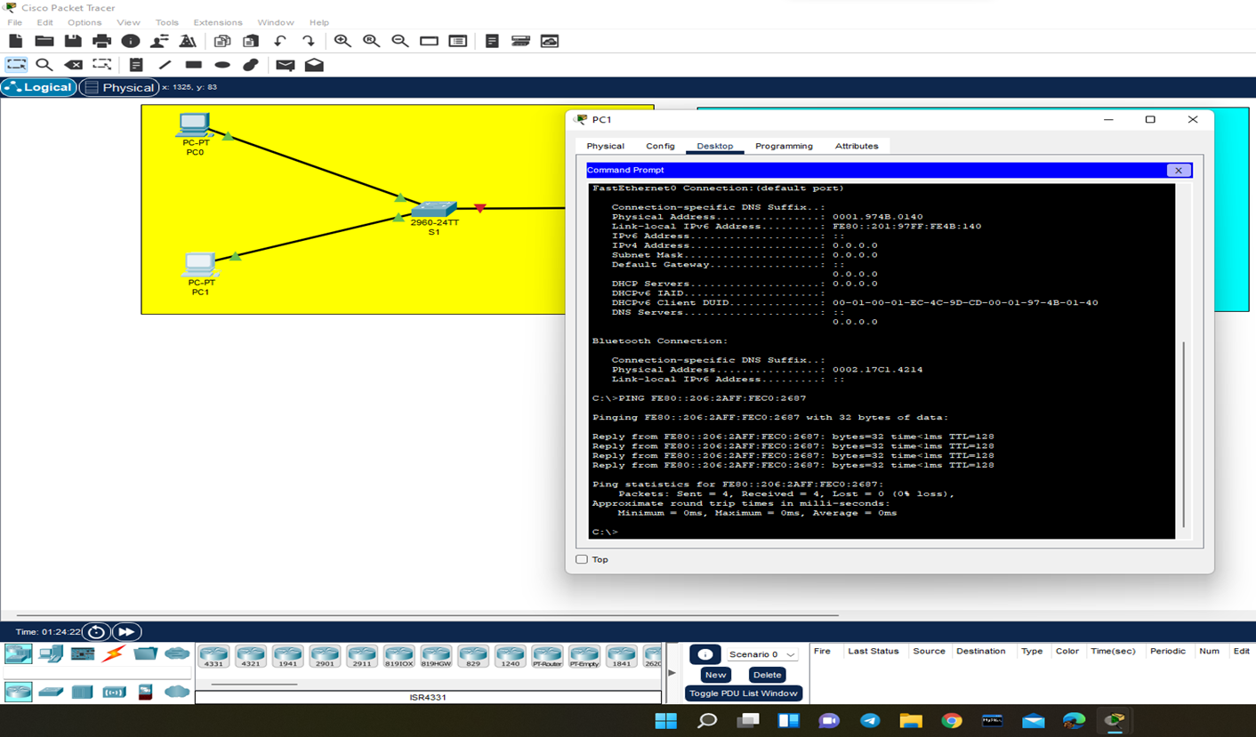
After that, we check whether we are getting the ack’s or replies for PC1 in its command prompt.

Slide 11
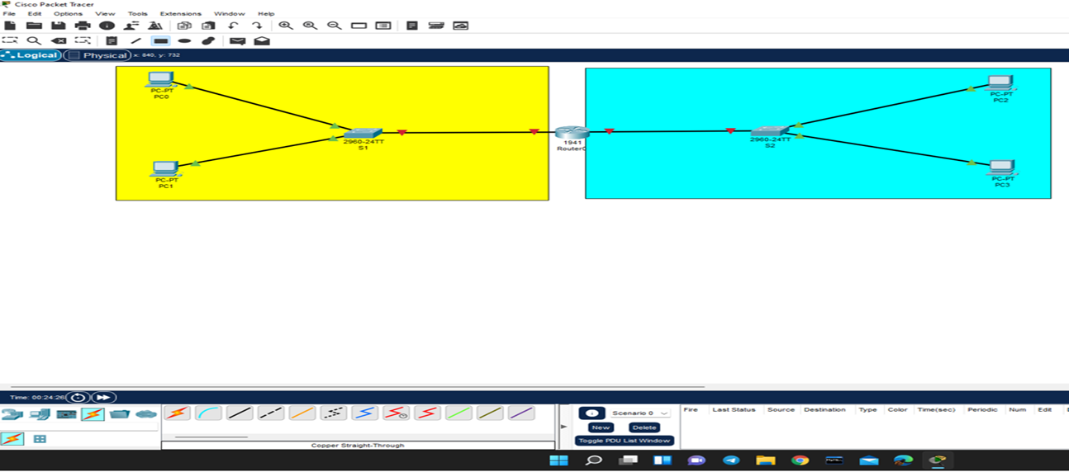
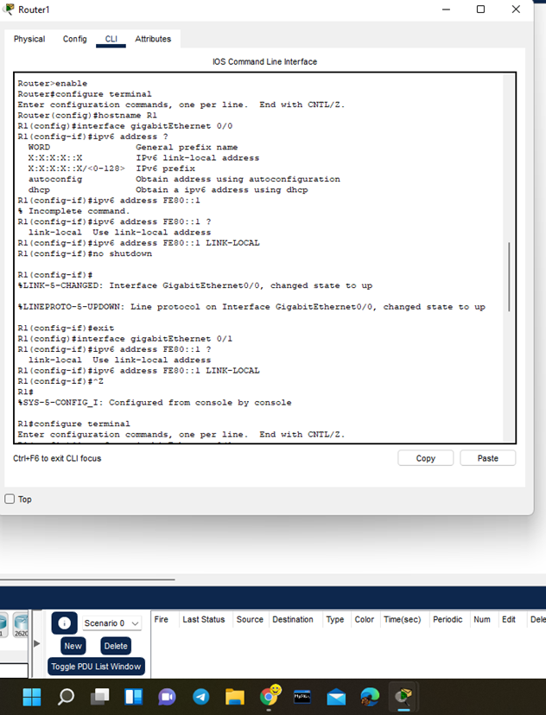
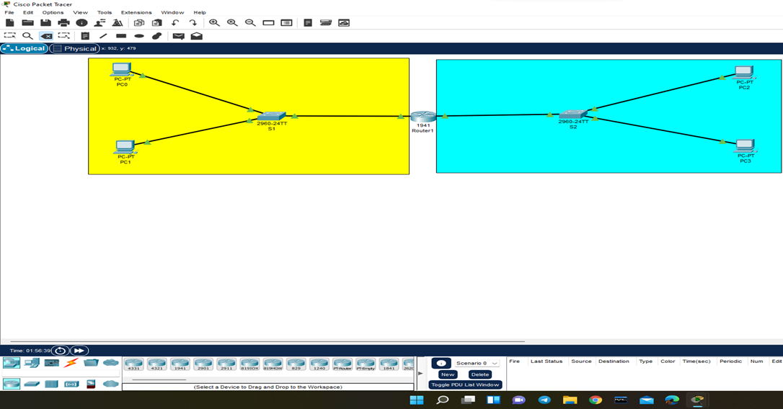
Enabling the transmission through router

Slide 12
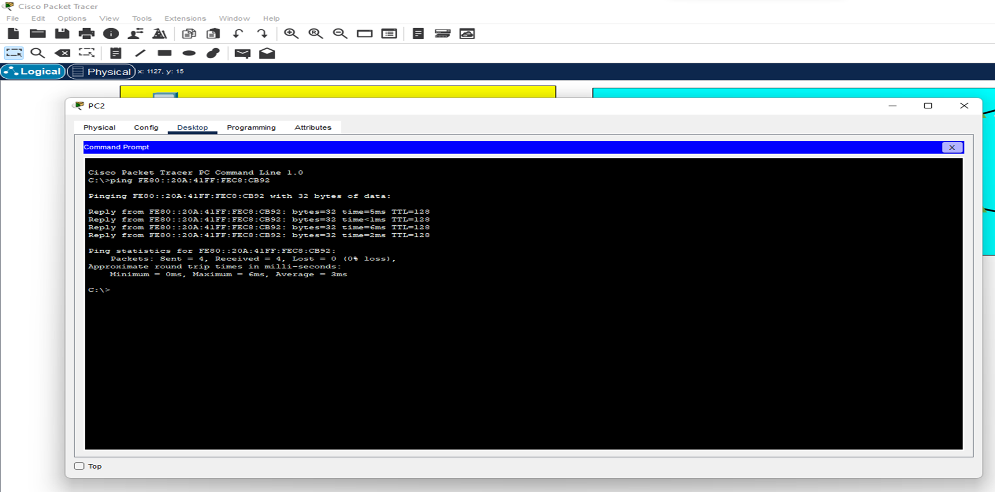
In the same way verifying the replies in second network also

Slide 13
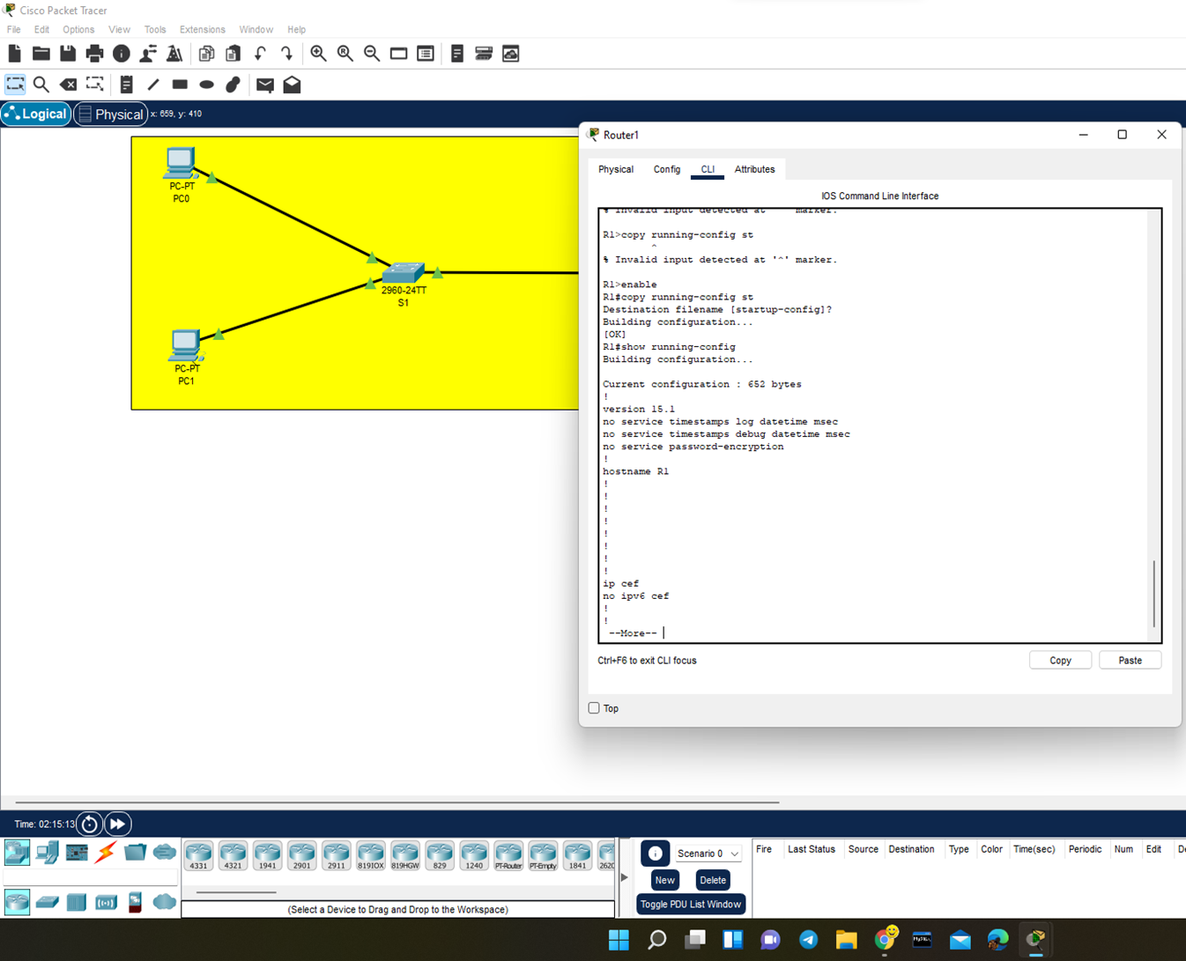
Transmission through router

Slide 14
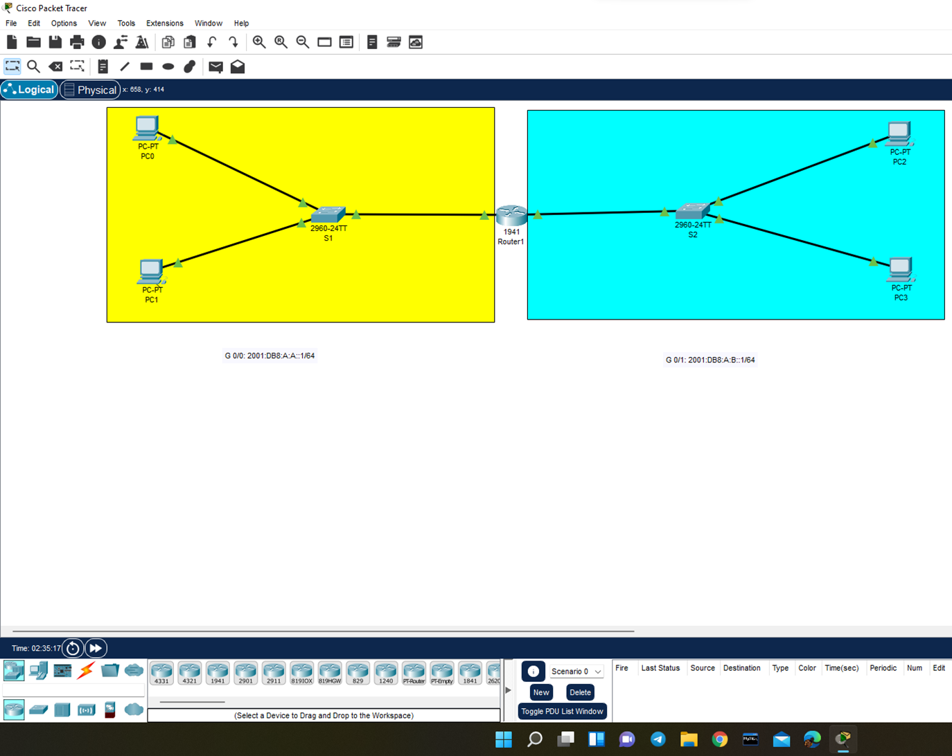
We are going to configure a global unicast address for these interfaces on this router(R1) so that these networks are going to communicate to each other. Here we assigned the ipv6 address i.e., the global unicast access for these interfaces g 0/0 and G 0/1 on this router R1

Slide 15
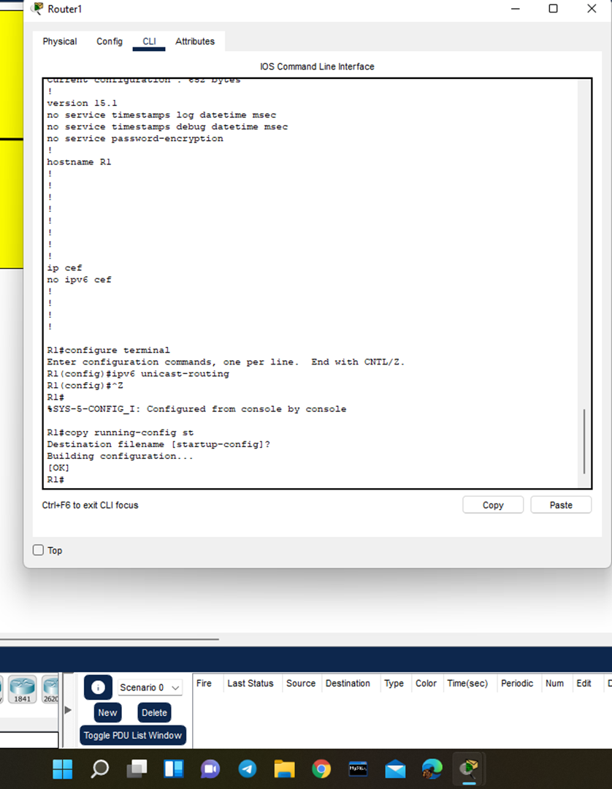
By default ipv6 traffic for waiting is disabled so we are enabling using ipv6 space unicast-routing

Slide 16
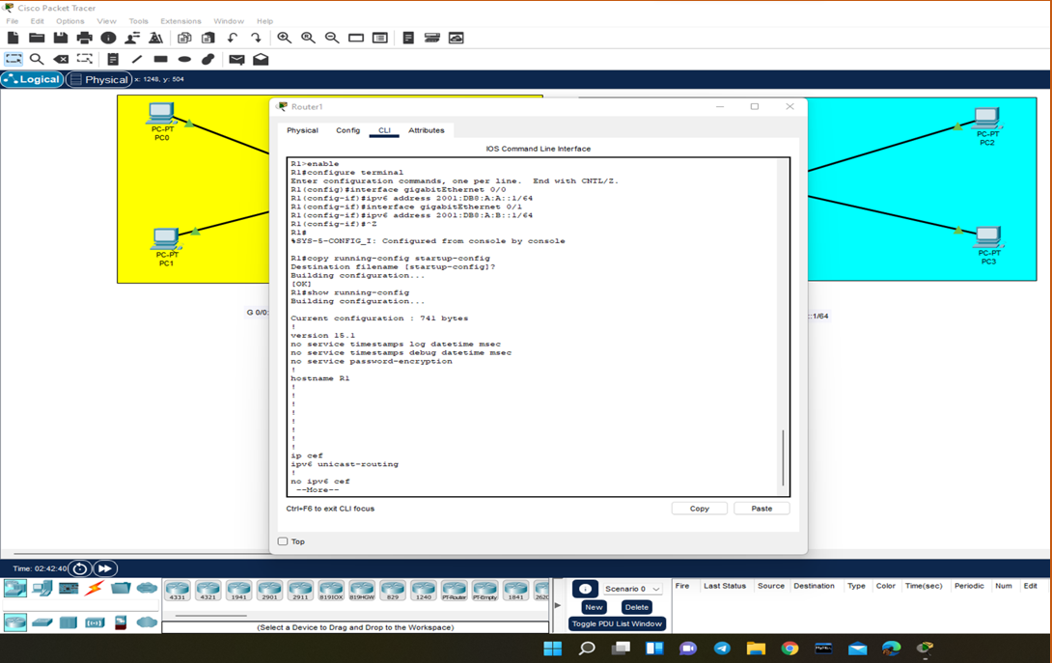

Slide 17
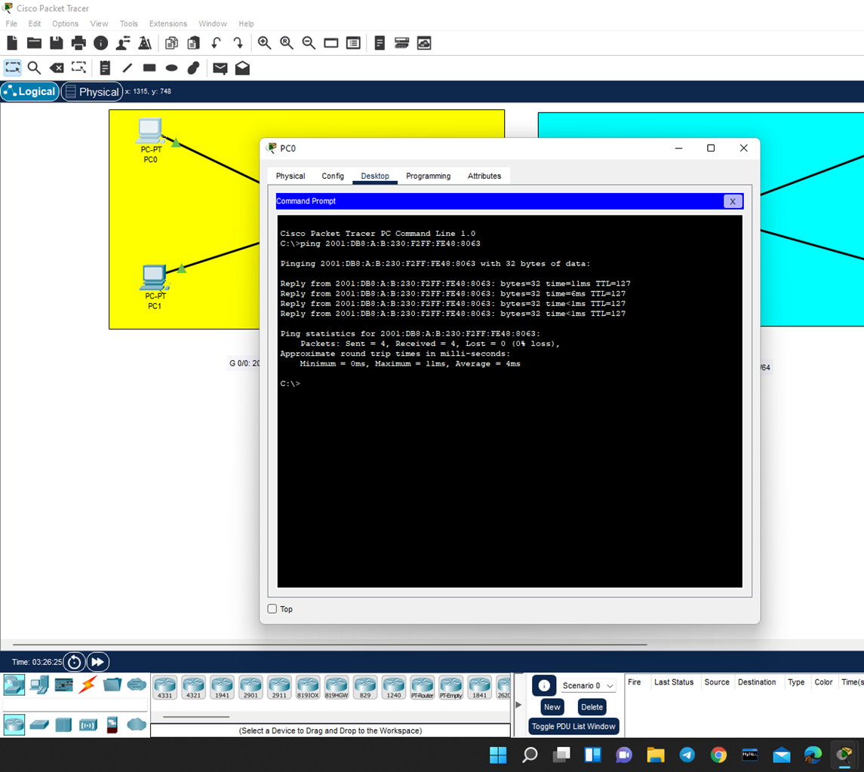
Finally, using the IP address of PC3 we check for replies from PC0.

Slide 18
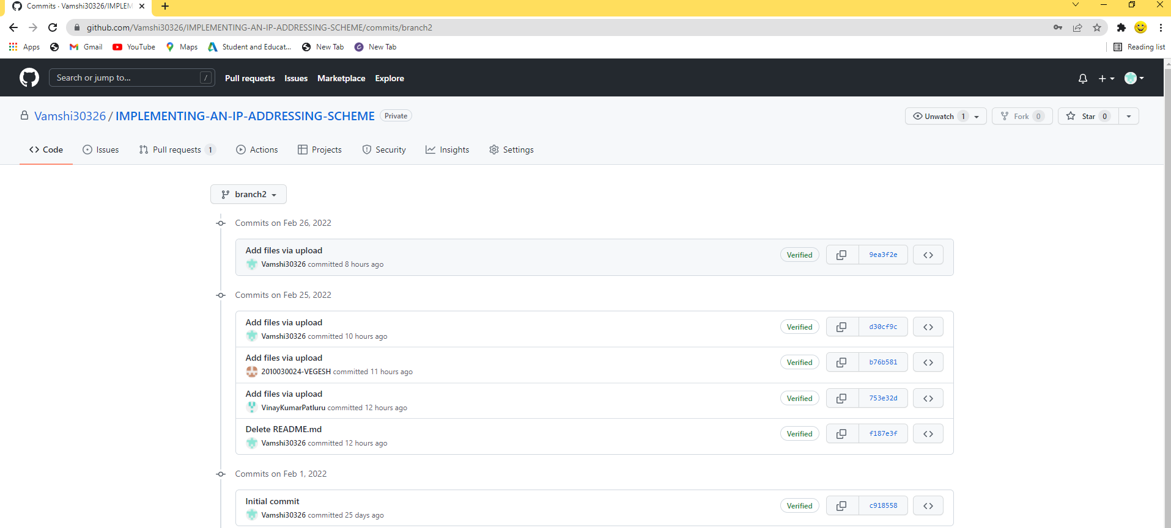
GITHUB COMMITS

Slide 19
THANK Q

